Slide 1
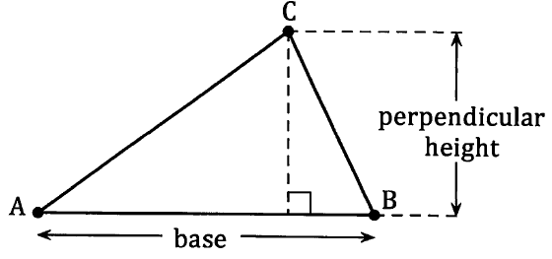
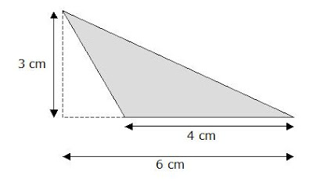
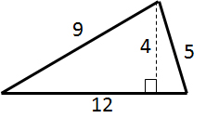
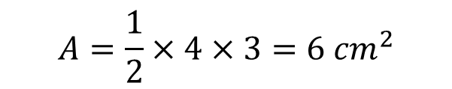
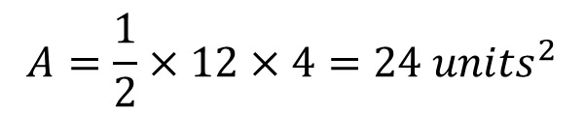
Area of a triangle – 1/2bh
We know from previous years’ studies and also from the Unit 1 and Unit 2 formula sheet, that the formula for calculating the area of a triangle is:
We need to make sure we use the base and the
perpendicular height (hint: they make a right angle).
Base = 12
$$A=\frac{1}{2}×12×4=24 {units}^{2}$$
Base = 4
$$A=\frac{1}{2}×4×3=6 {cm}^{2}$$
Height = 4
Height = 3

Slide 2
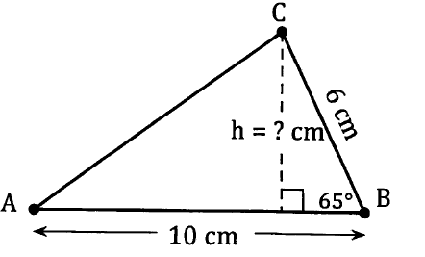
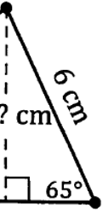


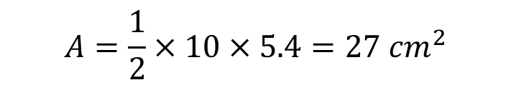


Area of a triangle – 1/2bh
Now do exercise 11A
If we are not given the perpendicular height of the triangle, we must calculate this before we can calculate the area of the triangle.
We might be able to do this using Pythagoras’ theorem (if we know two sides) or by using trigonometry (if we know a side and an angle).
Sin$65=\frac{x}{6}$
$$x=6×\sin{65}$$
Base = 10
$$A=\frac{1}{2}×10×5.4=27 {cm}^{2}$$
Height = 5.4
$$x=5.437…$$
$$x≈5.4 cm$$

